Slide 1
Energy Word Cards
Focus on Energy

Slide 2
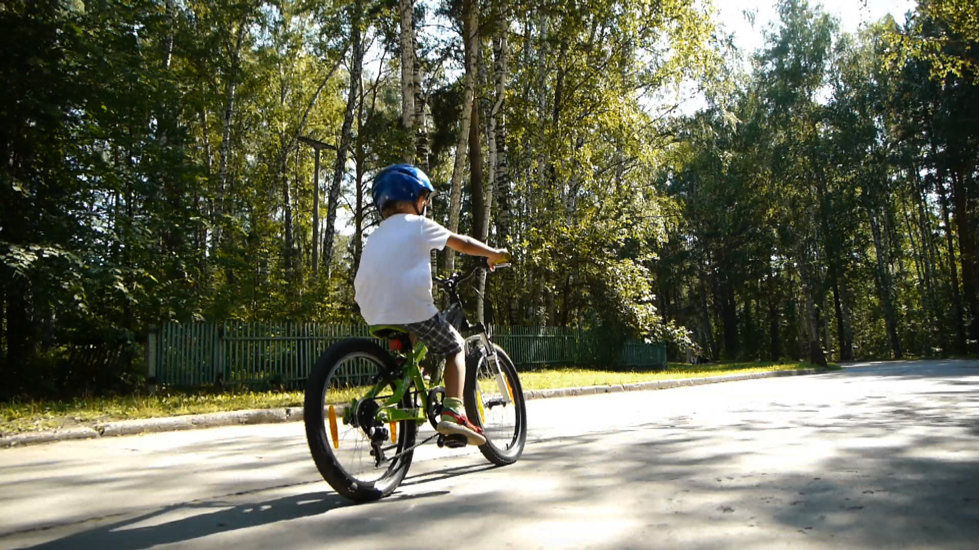
Motion Energy
An object has motion energy if it is MOVING

Slide 3
Observation
Use your senses
Vision
Touch
Hearing
Smell

Slide 4
Speed
The faster it moves, the greater its speed

Slide 5
Collision
Crash

Slide 6
Indicator
Clue or evidence

Slide 7
Representation
A description of something.
You can use
a drawing,
sketch, or words.

Slide 8
Transfer
Move from one place to another

Slide 9
Elastic Object
Returns to original shape when twisted, squeezed, or stretched.

Slide 10
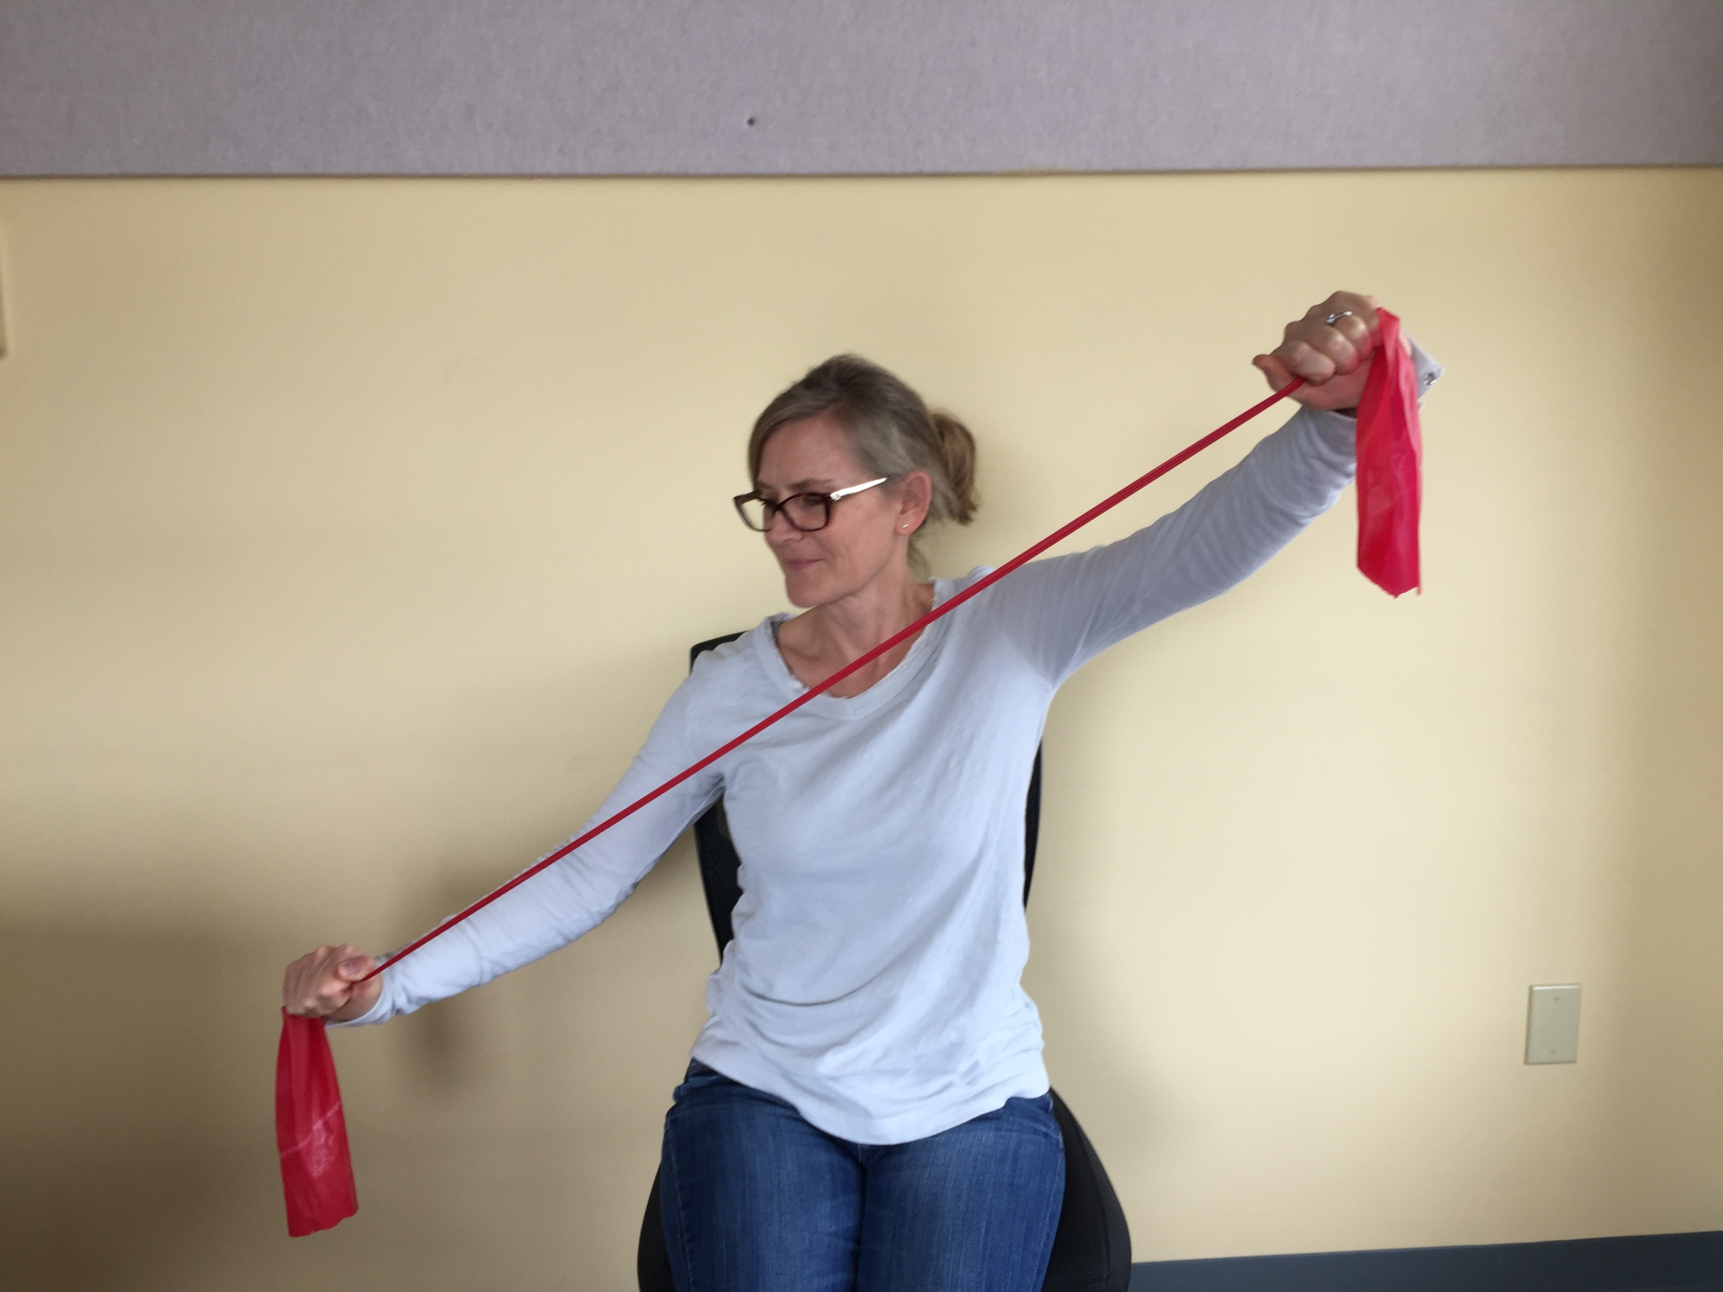
Elastic Energy
An elastic object has elastic energy when it is twisted, squeezed, or stretched.

Slide 11
Transformation
Change from one form to another

Slide 12
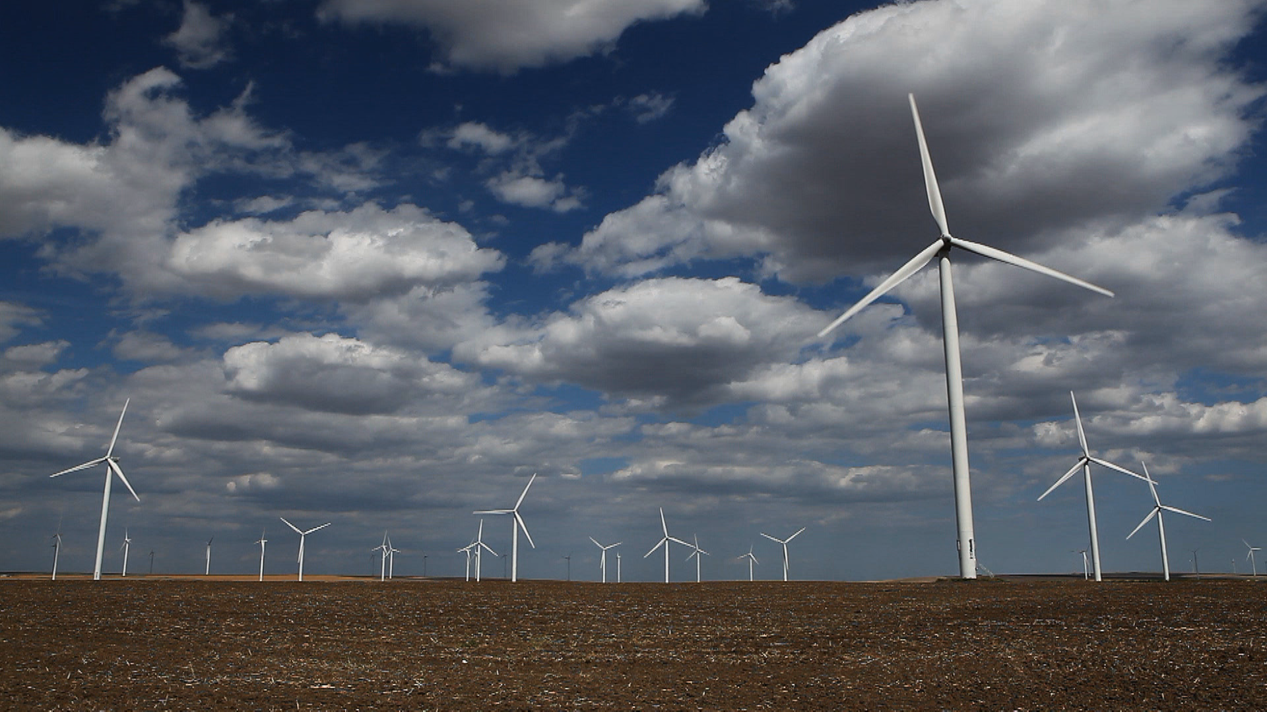
Energy Form
Type or kind of energy

Slide 13
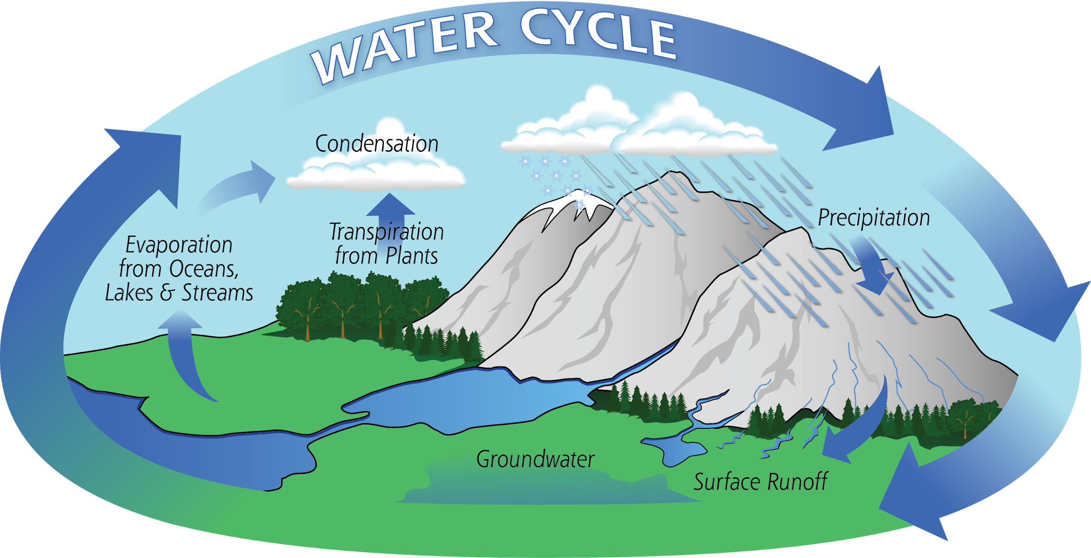
Scientific Model
A set of ideas that you can use to explain or predict something

Slide 14
Component
Part

Slide 15
Unit
A fixed standard amount

Slide 16
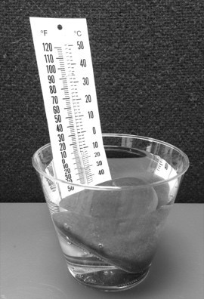
Thermal Energy
When an object gets warmer, its thermal energy increases.

Slide 17
Electrical Energy
Electricity carries energy from one place to another.

Slide 18
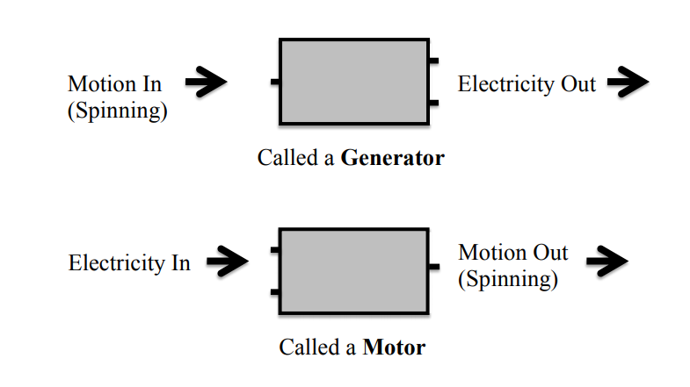
Motor & Generator

Slide 19
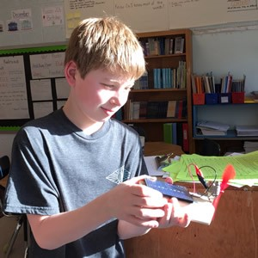
Solar/Light Energy
Light carries energy from one place to another.

