Slide 1
Materials Word Cards
Focus on Energy

Slide 2
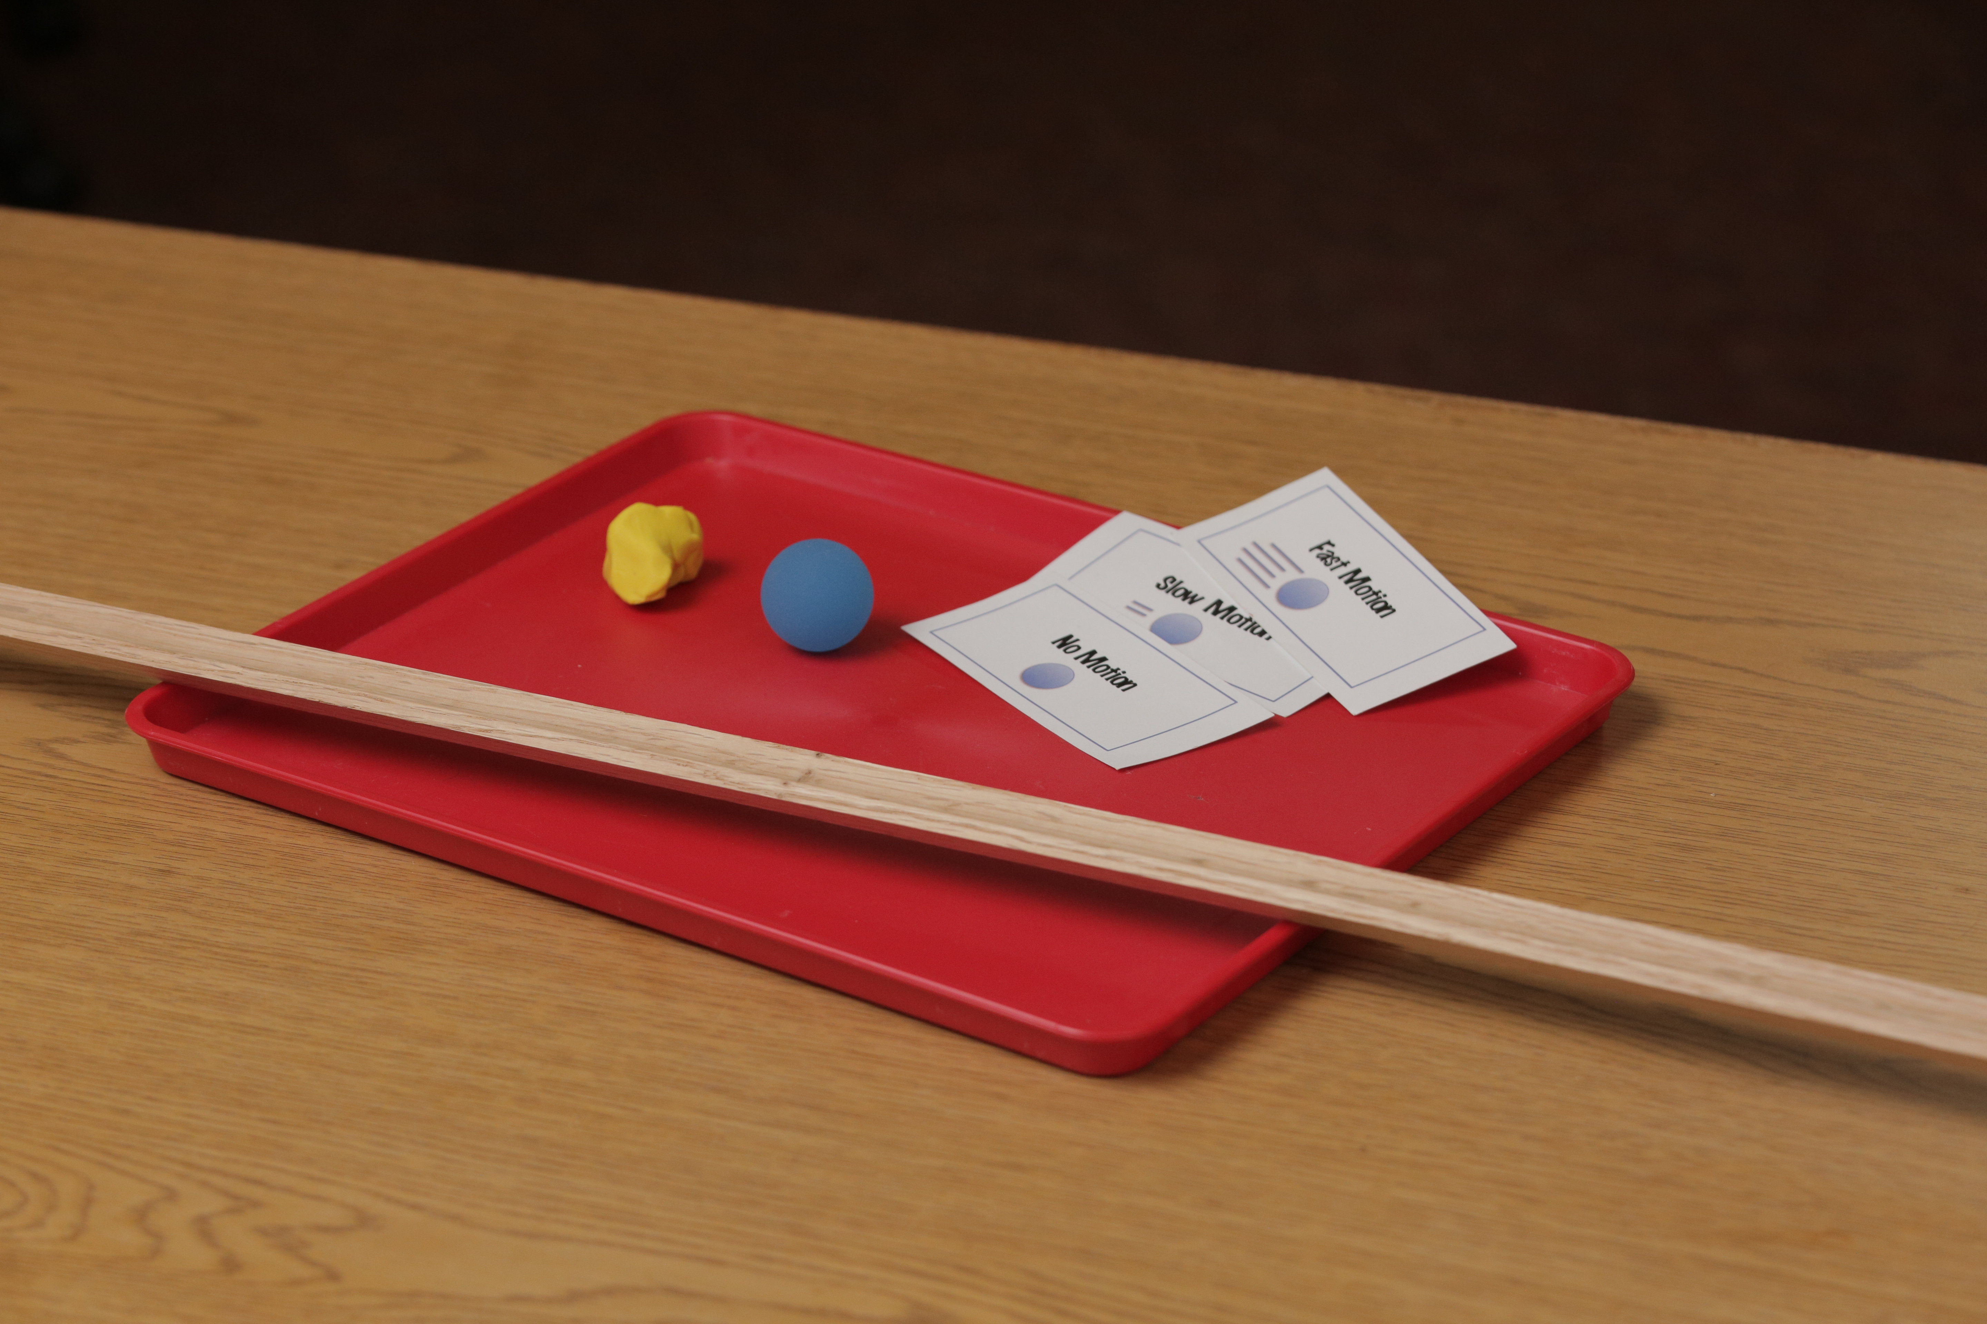
Motion 1
Plasticene
Ball
Motion Cards
Track

Slide 3
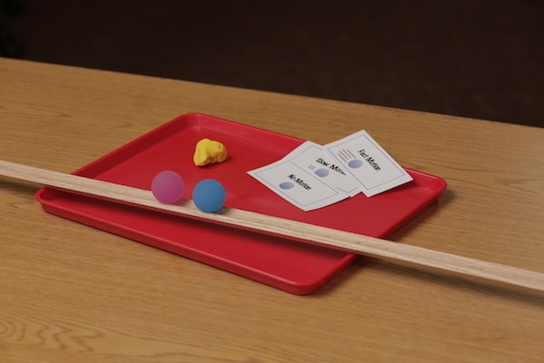
Motion 2
Plasticene
Ball
Motion cards
Track

Slide 4
Motion 3
Latch
Paint paddle
Energy cube
Pompom

Slide 5
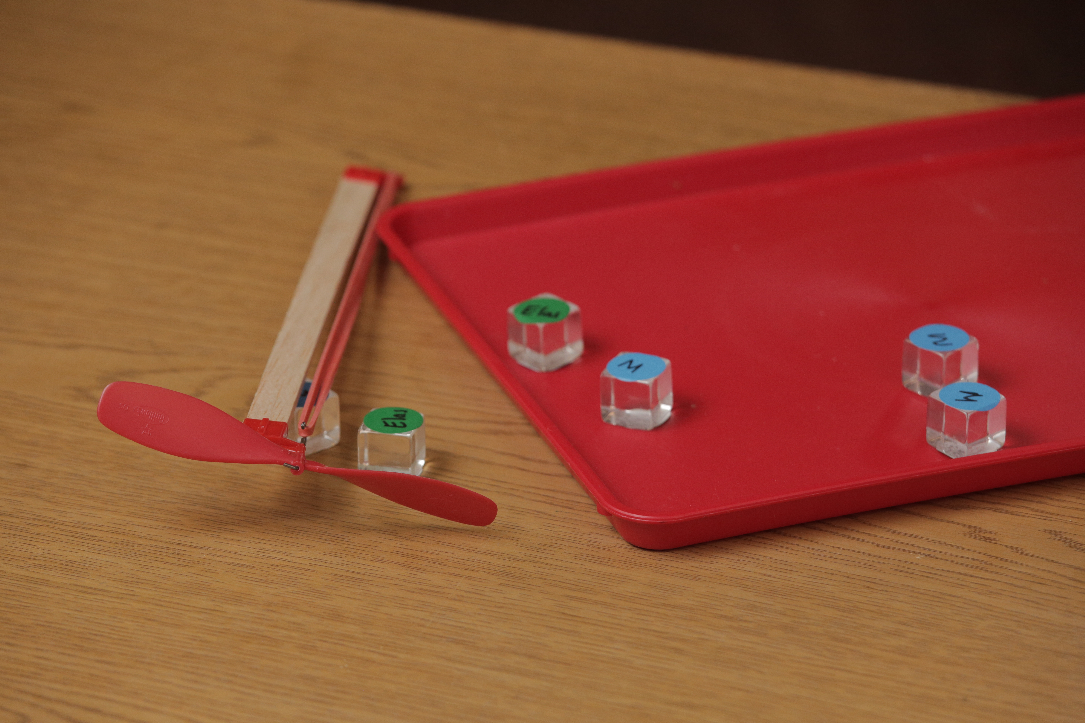
Motion 4
Propeller
Elastic band
Energy cube

Slide 6
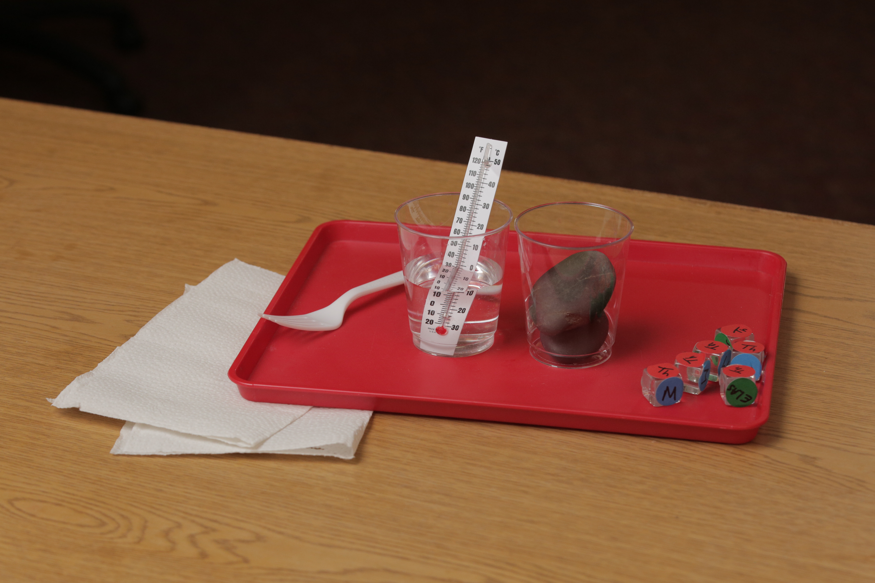
Thermal 1, 2A, 2B
Plastic cup
Thermometer
Rock
Fork
Water

Slide 7
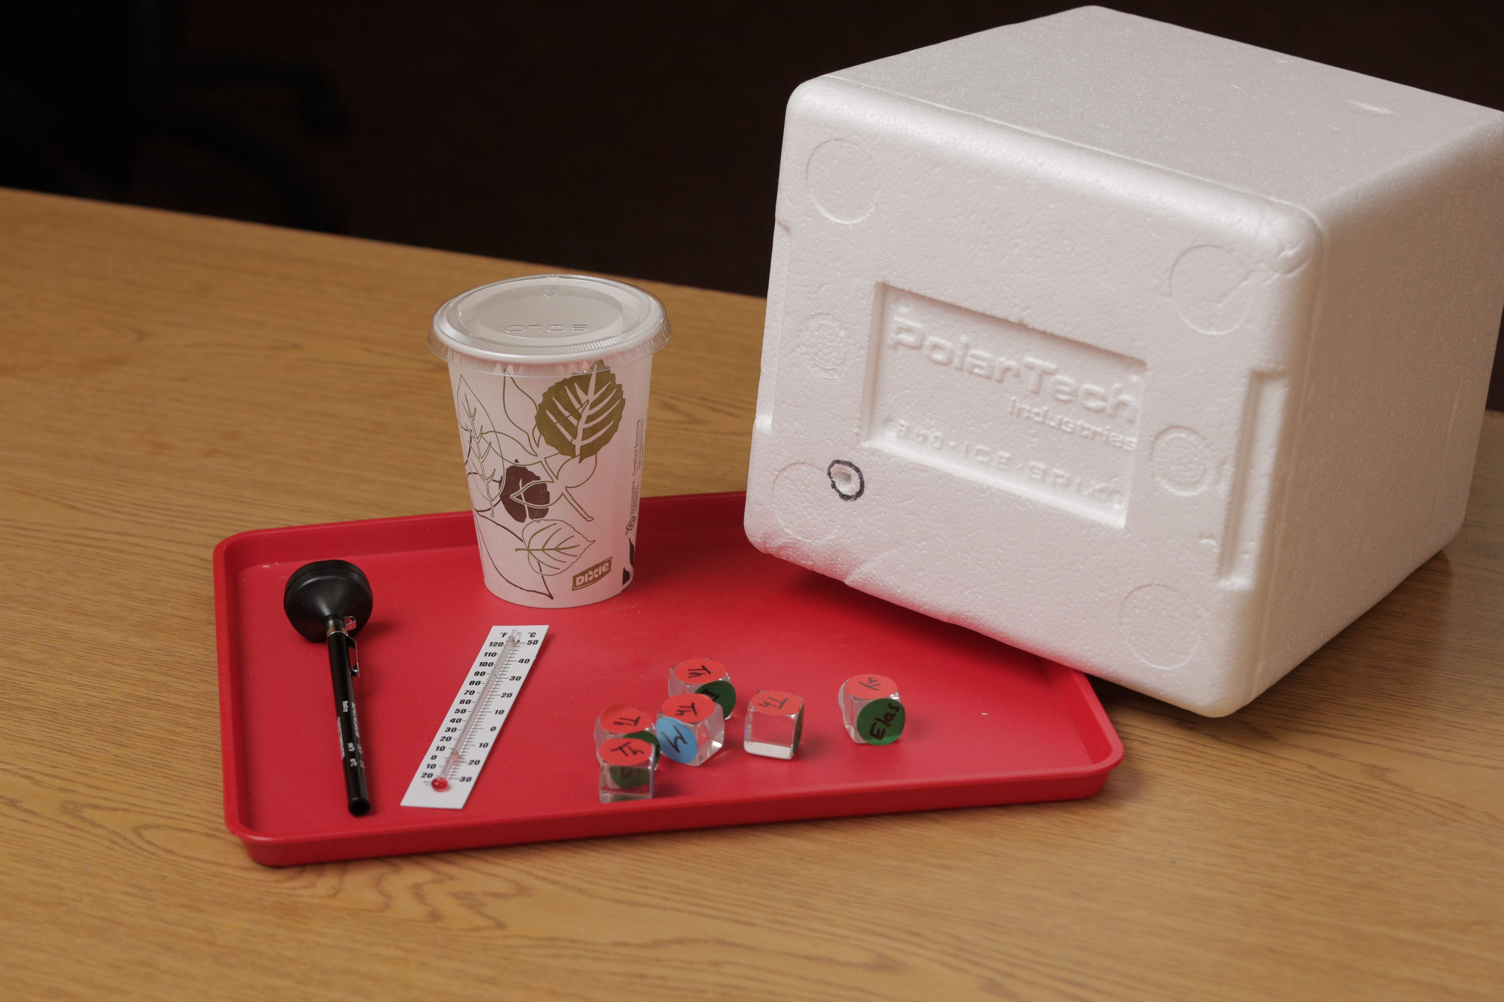
Thermal 3
Lid
Cup
Digital thermometer
Styrofoam box
Thermometer

Slide 8
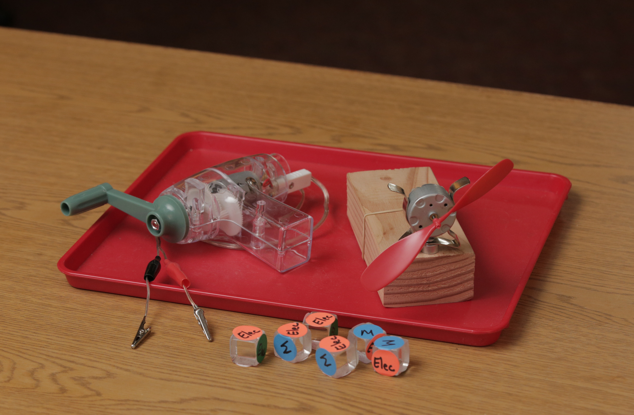
Electrical 1
Hand crank generator
Motor
Propeller
Wires
Energy Cubes

Slide 9
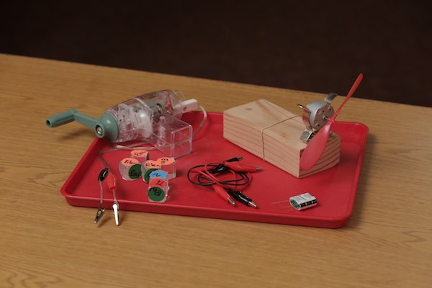
Electrical 2
Hand crank generator
Motor
Propeller
Cubes
Wires
Capacitor

Slide 10
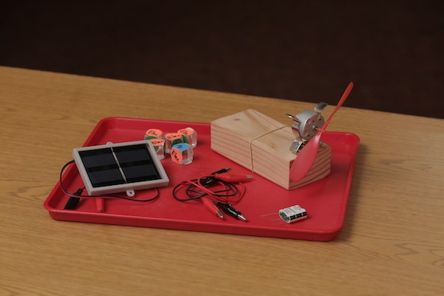
Electrical 3
Solar panel
Motor
Propeller
Wires
Capacitor

